Slide 1
T02 nocLock
Trampus, Jaimus, Shampus, Cameronmpus

Slide 2
Agenda
Project Motivation and Need
Design
Implementation
Testing
Results
Contributions and Lessons Learned
Q/A
Demo

Slide 3
Problem & Objective
Problem: Create an interesting alternative to traditional locking methods.
Objective: Work as a team to design, construct, and demonstrate a small project that fulfills course requirements.

Slide 4
Possible Solution
RFID
Card Key
NES controller
Biometric Scanner

Slide 5
Our Solution
<PICTURE PENDING>

Slide 6
Requirements
Device must lock and unlock.
Device must differentiate between many distinct knock sequences.
Device must be reliable. (i.e. stay locked/unlocked when expected)
Device should be user friendly and intuitive.
Device must be safe to operate.
Device must be affordable.
Device must be durable.

Slide 7
Approach/Overview of Project
Made decisions as a group
Multiple Decision Methods
Work was done by teams of two
Design
Verification
Consistent meeting times
Met every Friday

Slide 8
Inspiration & Research
Inspiration
Idea inspired by Adafruit ‘Secret Knock Detector’
Research
Bob Pease
Solenoid snubber circuit
Various Youtube Videos
Working with AVR
Timers, ADC, Interrupts, etc.

Slide 9
System Design

Slide 10
Design Approach
Started with top down design
Block Diagram/Flow Chart
Modular design methodology
Concurrent Engineering

Slide 11
Hardware Level 0/Level 1

Slide 12
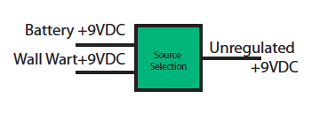
Power source select
Instant Backup
Option for charging
Decided to opt out of battery charging
Lower parts count
Lower total cost
Decided it would be unnecessary

Slide 13
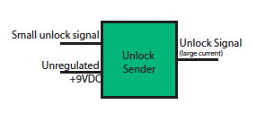
Unlock Sender
Depends on lock
Deliver large current
to solenoid.
Various driver options
Relay
Darlington Pair
Mosfet

Slide 14
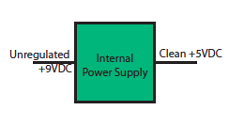
Internal power supply
Produce a clean
voltage supply.
IC regulators
Low cost as possible

Slide 15
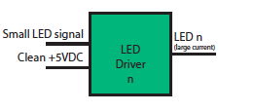
LED Driver
General purpose
switching.
LED types
Individual LEDs
Common Anode

Slide 16
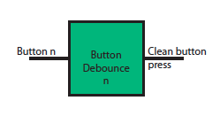
Button Debounce
Remove button bounce
Could have been S/W
Decided to include hardware debounce functionality.

Slide 17
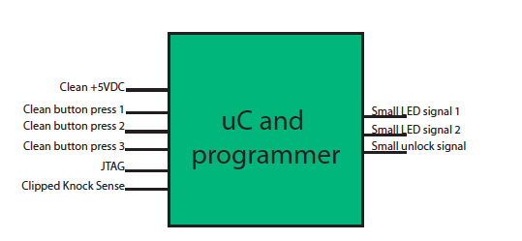
microcontroller
Central Module
Various choices
Cost
Simplicity
Availability
Decided lowest cost as primary concern

Slide 18
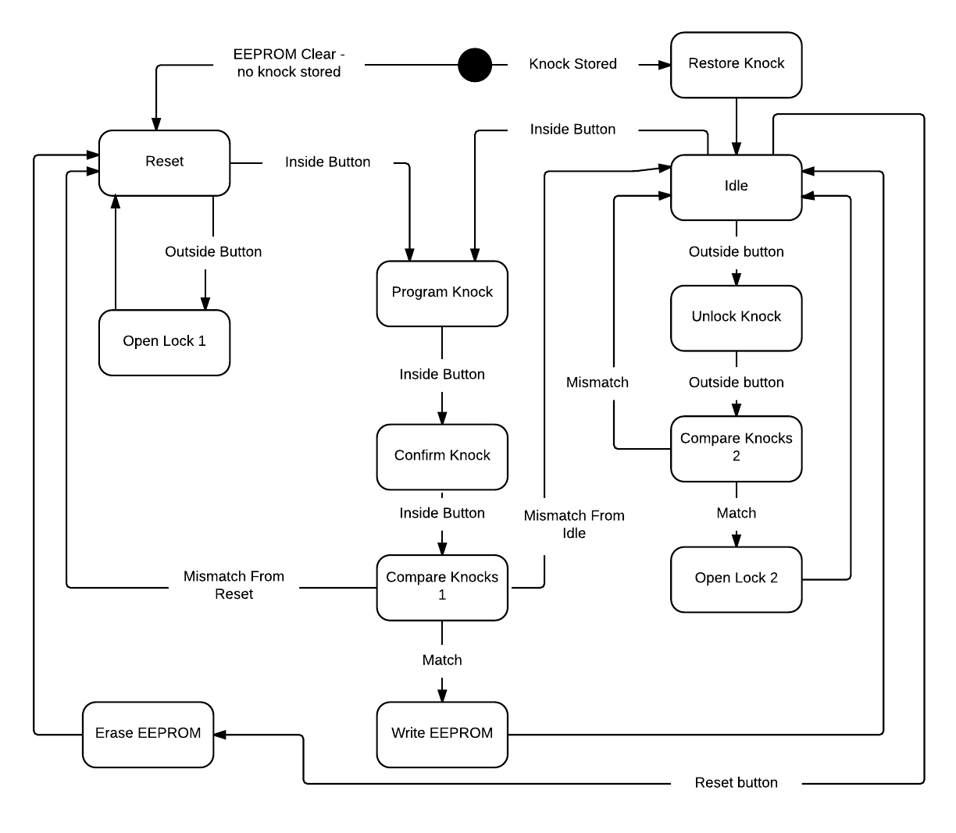
Software Flowchart

Slide 19
Software Algorithms
Knock Detection
ADC threshold
Knock Sensor Debounce
Timer starts after initial knock
Each Knock is stored at current time value
Knock is a collection of times
Knock Compare
Compare number of knocks
Compare timer values

Slide 20
Implementation

Slide 21
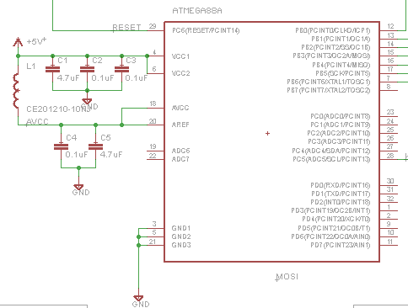
Microcontroller Subsystem
ATMega 88A
Isolated digital/ADC power supplies
Low cost and adequate memory
EEPROM too
Dev. tools available

Slide 22
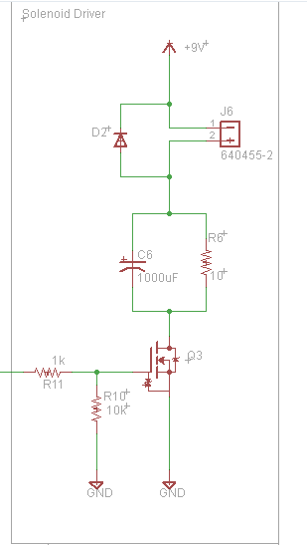
Solenoid Subsystem
MOSFET Switch
Clamp diode
Lowers voltage drop across solenoid
Reduction of power consumption from 400mA to 200mA

Slide 23
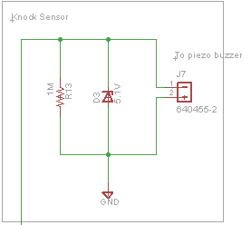
Knock Sense Subsystem
Protection diode clips voltage
Current drain
Connects via connector

Slide 24
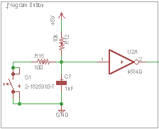
Button Debounce
RC circuit for smoothing bounces.
Schmidt trigger to create a fast rising edge
Combination removes button bounces

Slide 25
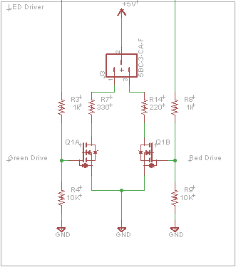
LED Driver Subsystem
Dual MOSFET
Designed to drive a common anode LED
Bi-Color LED
Connector allows exchangeable LEDs

Slide 26
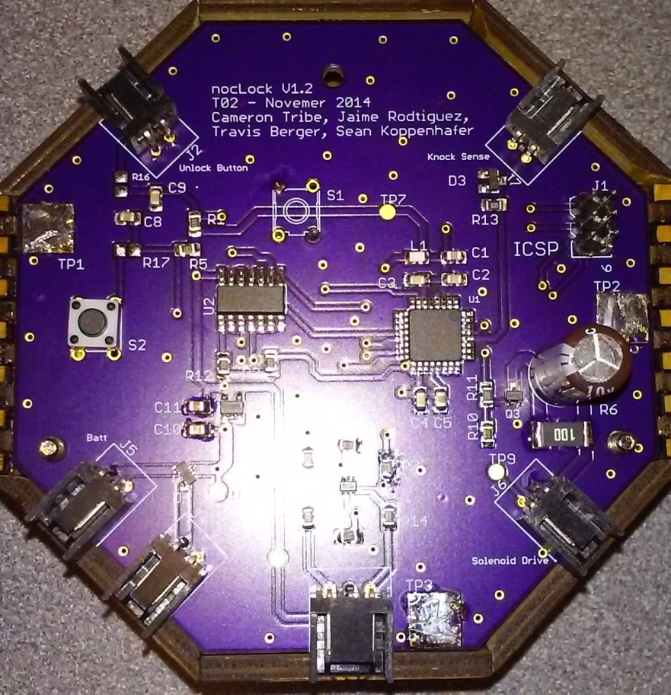
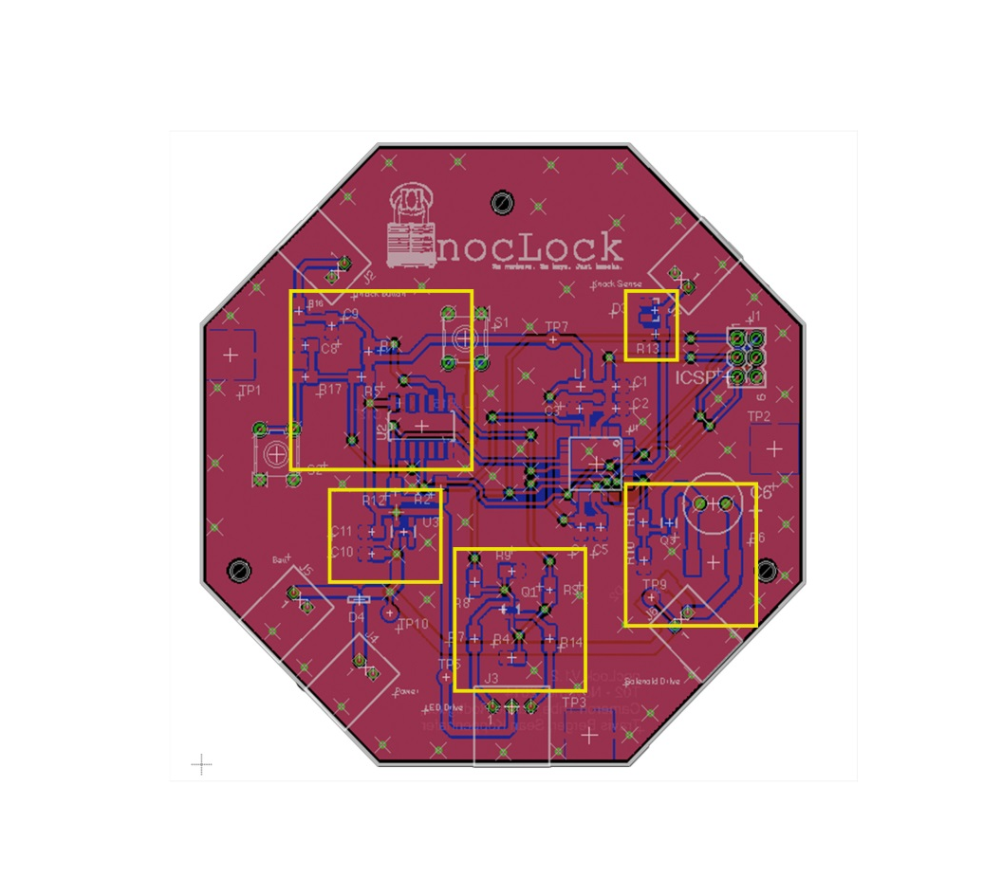
PCB Layout
Button
Inputs
Sensor
input
Power
Supply
Solenoid
LED’s

Slide 27
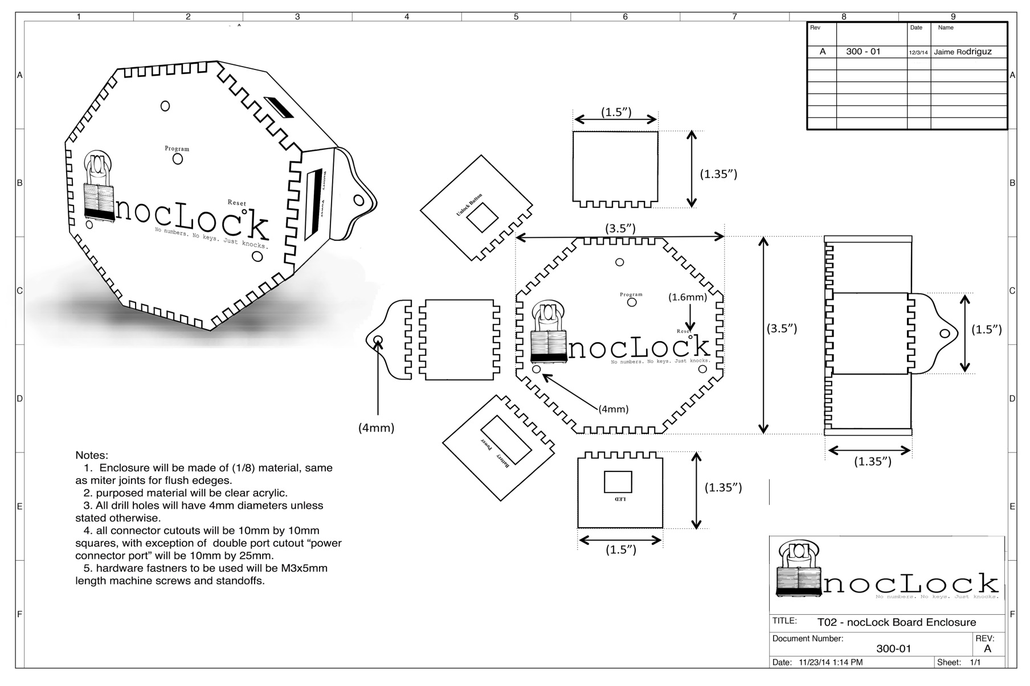
PCB Enclosure

Slide 28
Lock Box Design

Slide 29
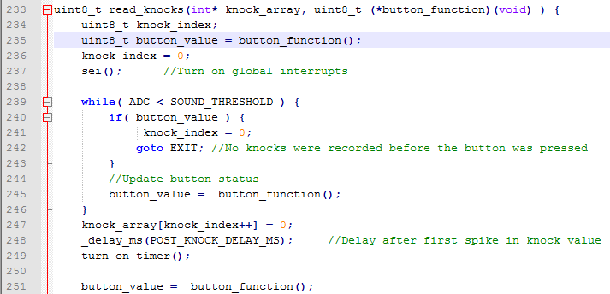
Read Knocks

Slide 30
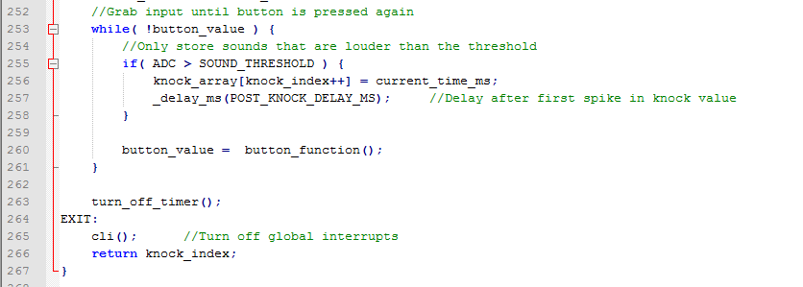
Read Knocks cont.

Slide 31
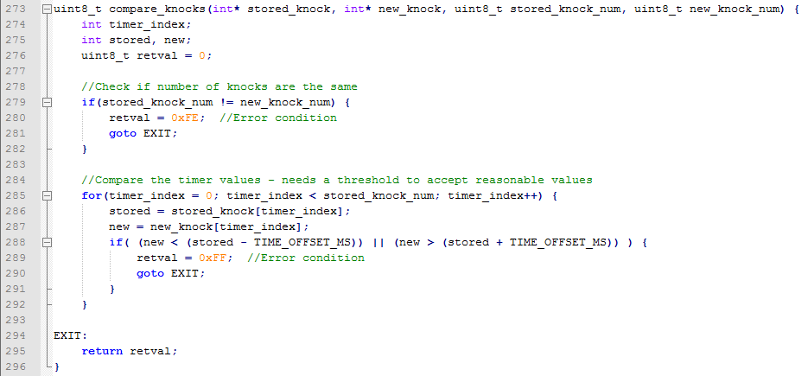
Compare Knocks

Slide 32
Testing

Slide 33
Testing Overview
Concurrent Engineering
Verification
Characterization
Test Categories
Modular Testing
Software Testing
Integration Testing
User Testing

Slide 34
Concurrent Engineering
Verification
Testing was started during the design phase in order to verify designs
When any changes were made to a design, the new design was verified before integrating that design with anything else
Characterization
Characterized performance of key components

Slide 35
Test Categories
Modular Tests
Modular Testing was done to remove as many variables as possible in order to identify bugs/problems
Module test passes were prerequisites for larger integration tests.
S0ftware Testing
Integration Tests
Integrated modules and tested performance of entire system.
Started by using stubs to simulate integration.
User Testing
Observed beta testing of project.

Slide 36
Results
Things that worked on the board:
Solenoid Driver circuit
Power Supply
LED Driver
Things that worked in our group:
Communication
Work balance
Flexibility

Slide 37
Results
Things that DIDN’T work on the board
Buttons
Software for buttons
Program button
ICSP
Things that DIDN’T work in our group
Github for schematics
Working too soon
Communication
Not enough work

Slide 38
contributions
Cameron
Travis
Sean
Jaime

Slide 39
Lessons - Cameron
Eagle CAD
Library management
PCB Layout
Schematic Drawing
Simple CAD drawings
EPL equipment
Microcontroller interfacing
Project management

